Slide 1

Management of Aflatoxins and control of Khapra beetle in Maize produced in Pakistan
By Dr. Mubarik Ahmed, Trade Development Authority of Pakistan

Slide 2
Introduction
Maize is the 3rd important food grain crop of Pakistan with estimated production of 9.5 million tons in 2024-25. This is less than production of 10.634 million tons during 2023-24.
Out of the maize production in 2023-24 about 9.739 million tons was produced in Punjab and 0.886 million tons in KPK.
The contribution of maize in agriculture value added product is 3 percent and 0.7 percent in GDP.

Slide 3
Top Exporters of Maize in the World (Value-Billion USD, Quantity-Million Tons)
Exporters | 2020 |  | 2021 |  | 2022 |  | % Share in World exports | Major Export Markets
 | Value | Quantity | Value | Quantity | Value | Quantity
World | 36.70 |  | 51.90 |  | 62.87
United States of America | 9.58 | 51.88 | 19.02 | 69.72 | 19.03 | 58.60 | 30.3 | China, Mexico, Japan
Brazil | 5.85 | 34.43 | 4.19 | 20.43 | 12.26 | 43.39 | 19.50 | Iran, Spain, Japan
Argentina | 6.05 | 36.88 | 9.06 | 39.95 | 8.61 | 33.01 | 13.70 | Viet Nam, Korea, Peru
Ukraine | 4.88 | 27.92 | 5.89 | 24.68 | 5.99 | 25.18 | 9.50 | China, Romania, Spain
France | 1.72 | 4.55 | 1.94 | 4.30 | 2.37 | 5.16 | 3.80 | Spain, Netherlands, Germany
Romania | 1.23 | 5.71 | 1.94 | 7.06 | 1.99 | 5.54 | 3.20 | Spain, Italy, Netherlands
Poland | 0.32 | 1.49 | 0.63 | 2.29 | 1.30 | 3.88 | 2.10 | Germany, Netherlands, UK
South Africa | 0.56 | 2.59 | 0.81 | 3.33 | 1.21 | 3.92 | 1.90 | Taipei, Chinese, Japan, Viet Nam
India | 0.39 | 1.77 | 0.94 | 3.62 | 1.12 | 3.49 | 1.80 | Bangladesh VietNam Nepal
Russian Federation | 0.40 | 2.29 | 0.69 | 2.94 | 0.85 | 2.52 | 1.30 | Turkiye, Iran, Korea

Slide 4
Top Existing Markets of Maize (Value-USD, Quantity-MT)
Country | 2020-21 |  | 2021-22 |  | 2022-23 |  | 2023-24
 | Value | Quantity | Value | Quantity | Value | Quantity | Value | Quantity
Grand Total | 23.195 | 109,237 | 244.570 | 775,360 | 190.455 | 630,389 | 324.029 | 1,421,637
Viet Nam | 11.802 | 54,139 | 144.251 | 441,514 | 80.456 | 256,034 | 164.641 | 723,298
Malaysia | 4.413 | 20,039 | 61.397 | 204,504 | 36.929 | 126,273 | 50.802 | 223,532
Sri Lanka |  |  | 3.011 | 8,831 | 13.042 | 36,469 | 45.718 | 186,077
Philippines |  |  |  | - | 0.173 | 500 | 15.526 | 61,023
Oman | 4.313 | 15,469 | 22.620 | 75,875 | 14.993 | 47,013 | 13.430 | 55,923
Bangladesh | 0.235 | 1,235 |  | - |  | - | 6.833 | 27,073
Yemen |  |  | 0.001 | 2 | 0.003 | 4 | 5.860 | 24,239
Qatar | 0.105 | 545 | 2.785 | 8,664 | 4.315 | 12,755 | 3.395 | 13,137
United Arab Emirates | 0.841 | 5,569 | 2.350 | 8,122 | 1.920 | 7,317 | 3.363 | 18,940
Bahrain/Kingdom Of Bahrain | 0.012 | 50 | 2.589 | 8,730 | 7.636 | 21,174 | 3.147 | 11,746
Afghanistan | 0.610 | 8,708 | 0.260 | 3,279 | 1.590 | 25,199 | 2.208 | 35,770
Hong Kong | 0.277 | 1,097 | 1.999 | 6,288 | 3.639 | 10,896 | 2.120 | 8,653

Slide 5
Major challenges in exports on account of food safety
Mycotoxins in maize and food preparations
Khapra beetle infestation in maize
Pesticide Residues in maize and food preparations (In significant)
Microbiological contamination (In significant)

Slide 6
Non-Compliance of agro products
Produce | 2023 | 2024 | 2025
Rice in EU due to Pesticide Residues | 36 | 68 | 16 collective PR & A
Rice in EU due to Aflatoxins | 13 | 20
Chilies in EU due to Pesticide Residues | 6 | -
Chilies In EU due to Aflatoxin |  | 23
Maize Collectively on account of aflatoxin and Khapra infestation |  | 80

Slide 7
Understanding of Aflatoxins

Slide 8
WHAT ARE AFLATOXINS?
Aflatoxins are naturally occuring metabolites synthesized by two types of fungi – Asparigus flavus and Aspargillus parasiticus
Aflatoxins contaminate dietry staples including maize, rice, ground nuts, chillies, dry fruits, animal feed, milk, etc
They are more abundant in tropical regions with high temperatures and humidity viz Sub-Saharan Africa and South East Asia

Slide 9
WHY ARE AFLATOXINS IMPORTANT
Aflatoxins are proven to be mutagens, carcinogens and teratogens
They produce disease called “Aflatoxicosis”
Aflatoxin B-1 produces cancer and affect liver by producing liver cirrhosis, necrosis and carcinoma and by suppressing by the immune system

Slide 10
TYPES OF AFLATOXINS
There are 4 types of aflatoxins found in cereals
B1 (AFB1)
B2 ( AFB2)
G1 (AFG1)
G2 (AFG2)

Slide 11
Pre and Post Harvest Factors that Contribute to Aflatoxins
High temperature
High humidity
High moisture content

Slide 12
Permissible limits for Aflatoxins
Different contries have set different limits of tolerance
COUNTRY | LIMIT
India | 30 ppb
Pakistan | 30 ppb
USA | 20 ppb
Australia | 15 ppb
China | 20 ppb
Egypt | 10 ppb (5 B1)
Japan | 10 ppb
Russia | 5 ppb B1
European Union (processed) | 4 ppb ( 2 B1)
European Union (unprocessed) | 10 ppb (5 B1)

Slide 13
Key to Aflatoxins Management
Harvesting of mature crop
Immediate thrashing after harvest
Immediate and appropriate drying after harvest
Cooling right after drying before bagging
Storage in well ventilated and clean stores
Proper periodic aeration in case of silo storage

Slide 14
Farm Level
Use of disease free and healthy seed
Implementation of GAP, GDP, GSP using suitable pesticides for the control of pest and diseases
Proper drying using suitable drying surfaces
Measure to control mixing of damaged and undamaged crop
Development of rapid and cheap procedures for determining aflatoxin by the farmers
Technical support to the farmers

Slide 15
Market Level
Using suitable, ventilated stores for storage
Reorganisation of central market structure to eliminate the mixing of fresh and old crop
Developing a system to assess aflatoxin
Training and resource development for operators working in the marketing channel
Provision of support to farmers on quality level
Implementation of grading standards based on scientific lines

Slide 16
Public Sector
Investment and support to the public sector organisations for undertaking research on pre and post harvest problems
Development of legislature framework for preventing the marketing of substandard products
Organising training of stakeholders through farmer field schools and other dissemination procedures
Development of reference laboratories for determining aflatoxins

Slide 17
How to check Aflatoxin in Maize
Aflatoxins can be checked by using one of the following procedure from the DPP approved laboratories in Pakistan
TLC method
Elisa testing
HPLC/LCMS testing
The approved laboratories are:
HEJ Institute of Chemistry, Karachi
PCSIR labs Lahore and Karachi
NIBGE, Faisalabad
MNS University of Agriculture, Multan
NARC, Islamabad

Slide 18
Management of Khapra Beetle in maize

Slide 19
What is Khapra Beetle
Khapra beetle (Trogoderma granarium) is an insect pest that is known to infest more than 90 commodities
The primary host is wheat but it also damages Barley, Oats, Rye, Maize, Rice, Flour, Malt, Noodles, Chilies, Dry Fruits, Oilseeds etc.
Khapra is a storage pest and also infest the packaging material.
The adults are short lived and damage is caused by larvae. The insect can survive up to 9 months without any food and live in diapause
Khapra is rated as one of the most destructive insect and is considered a quarantine pest.
Pakistan in the past has faced bans on the export of rice by Russia and Mexico due to presence of this pest.
Our Maize consignments (more than 65) have been intercepted by Vietnam and Malaysia last year and both the countries have sent alert notifications.

Slide 20
Sources of infestation
The prime source of infestation are:
1. Use of old jute bags
2. Infested godown
3. Transporting vehicle
4. Docks
5. Improper fumigation

Slide 21
Why is khapra a quarantine pest
Khapra is a very difficult insect to kill
It is very destructive for stored products
It can feed on several commodities
It can live for 9 months without food
It can survive at variable temperatures
It closes its breathing tubes during fumigation
It enters In diapause under un-favorable conditions

Slide 22
Difficulties in control of Khapra
Many countries around the world has spent billions of dollars to eradicate khapra from their territories and are conscious to prevent its re-introduction

Slide 23
Rate of Propagation of Grain Pests
Insect Species | Averarge number of eggs per female | Average time takes to complete one generation (days) | Progeny of one pair in time (months)
 |  |  | (1) | (2) | (3)
Angoumois Grain moth (sitotroga cerealella) | 100 | 26-28 | 50 | 2,500 | 125,000
Khapra Beetle (Trogoderma granarium) | 102 | 24-30 | 51 | 2,602 | 132,651
Rice Weevil (Sitophilus Oryzae) | 200 | 28-30 | 100 | 5,000 | 250,500
Lasser Grain Borer (Rhizopertha dominica) | 400 | 24-30 | 200 | 20,000 | 2,000 million
Red Flour Beetle (Tribolium Castaneium) | 450 | 26-30 | 225 | 25,312 | 2.8476 millon
Rate of propagation of the five important species of stored grain insect pests under ideal condition of temperature and humidity.
It is assumed that egg viability is only fifty (50) per cent in each species and that sex ratio is 1:1 in each case

Slide 24
Five Principles to keep maize free from khapra during storage
Keep grain cool and dry.
Keep storage biologically clean.
Protect from pests.
Inspect regularly.
Undertake control measures in case infestation is detected.

Slide 25
The Biological Feedback Mechanism
The impact of Respiration
Temperature
Respiration
Bacteria Fungi
Rel. Humidity moisture Cont.
Insects
The impact of Bacteria & Fungi
Temperature
Respiration
Rel. Humidity moisture Cont.
Bacteria Fungi
Insects
The impact of Insects
Respiration
Temperature
Bacteria Fungi
Rel. Humidity moisture Cont.
Insects

Slide 26
Practical Application of Pesticides to Control Pests in Stored Products
Pesticides are applied in food storage and processing premises or to grain with the
following objectives in mind:
Prevention - to ensure that an empty structure in which is intended to keep food is free of pests.
Protection - to ensure the safekeeping of food stored in a warehouses.
Correction - to combat infestations which have developed.

Slide 27
What is a Fumigant?
A fumigant is a chemical which exists in the required temperature and pressure in sufficient concentration to be lethal to a pest providing the exposure to that chemical conc. Lasts for an adequate period of time.
All fumigants are respiratory poisons.
All fumigants kill all stages of an insect egg larvae pupae adult

Slide 28
Types of Fumigants
Phosphine (dosage 3-5 g per cubic meter)
Methyl Bromide (dosage 60-80 g per cubic meter)

Slide 29
Properties Of Common Fumigants
 | Phosphine | Methyl Bromide | Carbon dioxide | Hydrogen Cyanide
Formula | PH3 | CH3Br | Co2 | HCN
Molecular weight | 34 | 95 | 44 | 27
Boiling Point | -87.0 | 3.6 | -78.5 | 25.7
Specific gravity (gas) (air=1.0) | 1.2 | 3.3 | 2.0 | 0.9
Vapour Pressure at 30C (atm) | 42 | 2.5 | 71 | 1.2
Conversion factor g/m3 to ppm (30oC, 1 atm) | 730 | 260 | 560 | 890
Flammability Limits in air (v.v) | >1.7% | 13.5-14.5% | Nonflammable | 6-46%
Solubility in water (v/v) | 0.2 | 3.4 | 0.76 | Highly soluble
Specific gravity at 30OC, (Liquid, kg/L) | - | 1.7 | 0.93 | 0.69

Slide 30
Pre-Requisites of Fumigation
Air Tight Enclosure
Application and Retention of Lethal Dose (Concentration x Time)

Slide 31
Impact of Godown Leakiness on Gas Retention
If the Godown Leakiness is 50% then 1000 ppm dose after 24 hours will only be 500 ppm and after next 24 hours 250 ppm.
Thus, on the 4th day of Fumigation, the Lethal Concentration will not be there.

Slide 32
Minimum Duration of Fumigations with Phosphine
Temperature oC | Duration of fumigation, days after application of fumigant
>12o | Do not use phosphine
12-20 | 14
22-25 | 12
26-30 | 10
<30 | 10
Do not attempt to fumigate for less than the minimum exposure period recommended. Where possible give the maximum possible exposure period. If in doubt, fumigate for 15 days.
Recommendations for minimum exposure periods issued by manufacturers of phosphine formulations are often too short for full control to be achieved in many instances.

Slide 33
Usage of Methyl Bromide
Situations | Considerations
a) Stacks under gas proof sheets | Piping layout and Jets. Walls or channels. Sheeting and sealing.
b) Space or “ in-store” fumigation | Adequate distribution. Retention of gas and sealing.
c) Chamber-type fumigation i) Atmospheric fumigation. ii) Fumigation | Correct loading. Dosing and circulation. Aeration.
d) Silos | Forced circulation. Leakage.
e) Ships | Adequate distribution. Retention of gas in treated areas. Hazards to crew. Delay and costs.
f) Flour and other finely divided commodities. | Vaporization of fumigant. Residues/

Slide 34
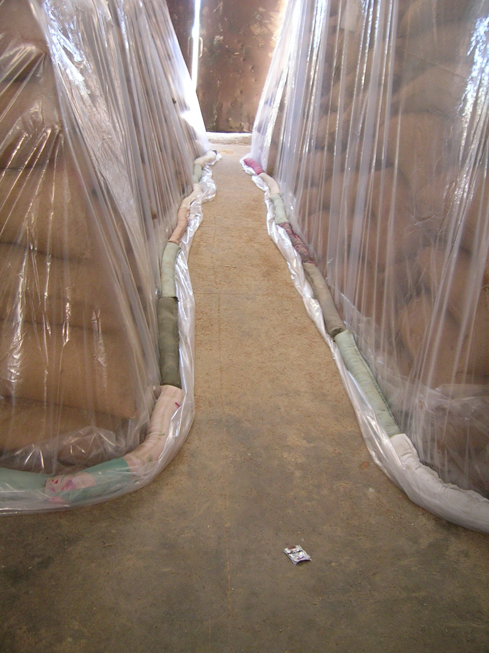
Options for Godown Fumigation
Dosage Rate High Normal Low
Application Type Single Multiple
Level of Resistance Susc. Resistant
Exposure Period 5, 6 ,7,8,9,10 + Days
Gas Retention of Godowns 0-X% SD
Wind speed X -Y changes X-Y% MD Y+ = No.

Slide 35
Thank You!

